Slide 1
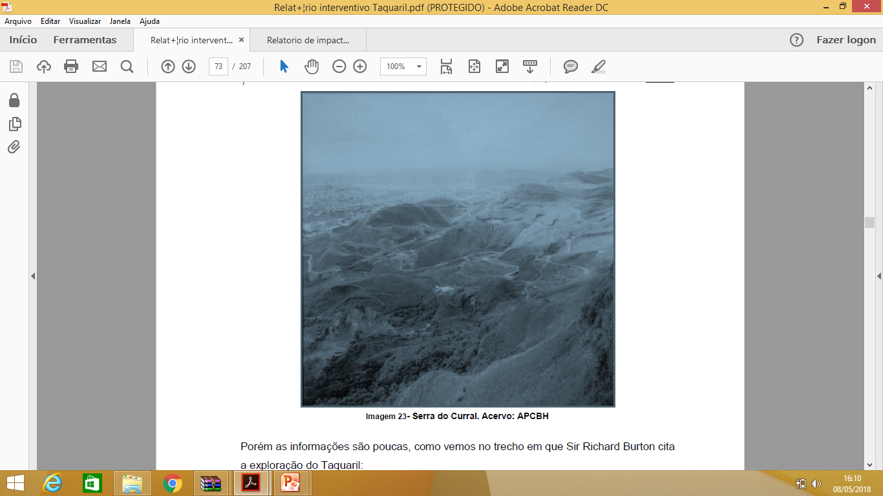
Serra do curral um futuro ameaçado

Slide 2
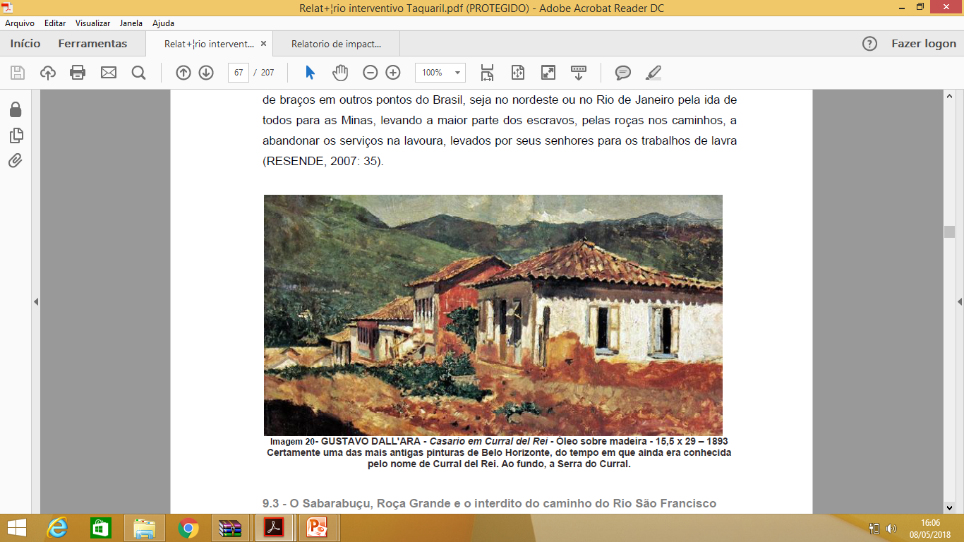

Slide 3
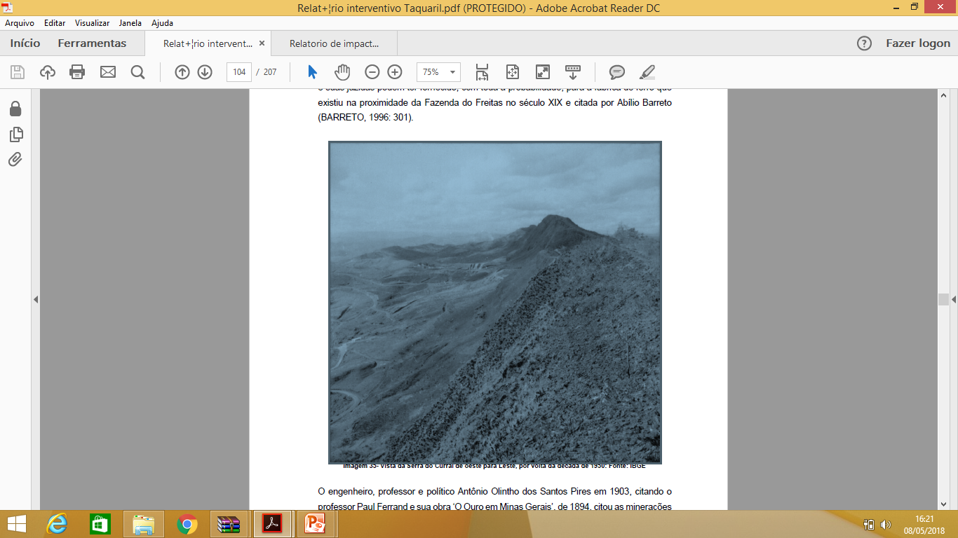

Slide 4
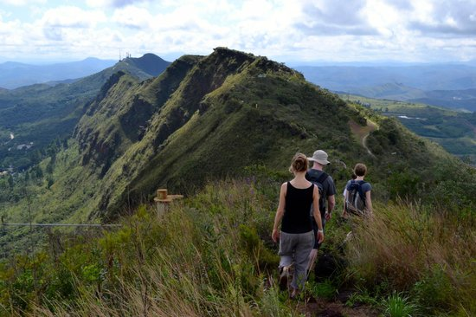

Slide 5
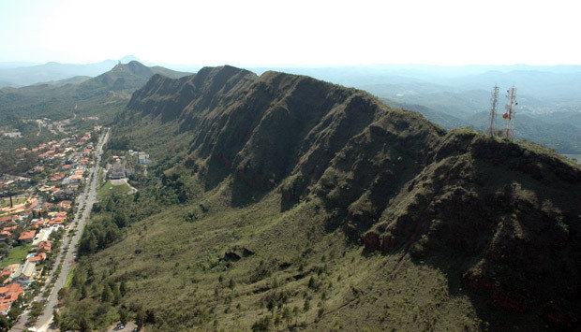

Slide 6
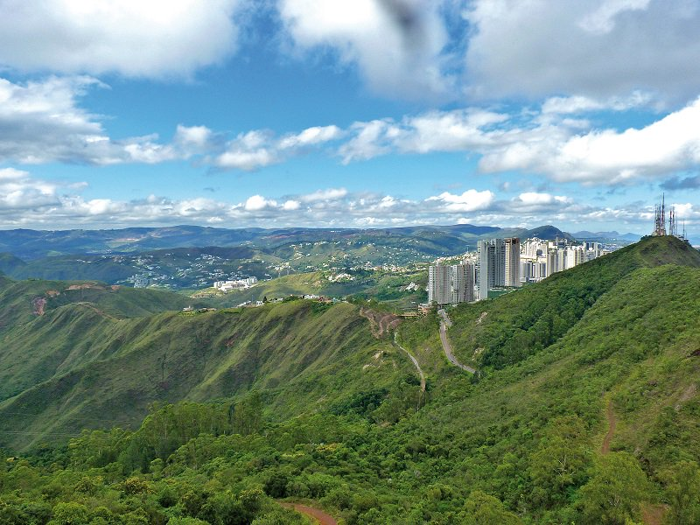

Slide 7
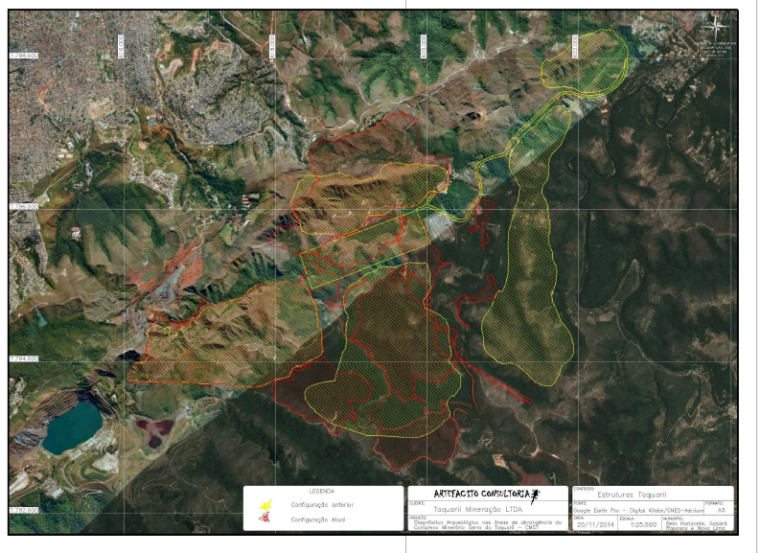

Slide 8
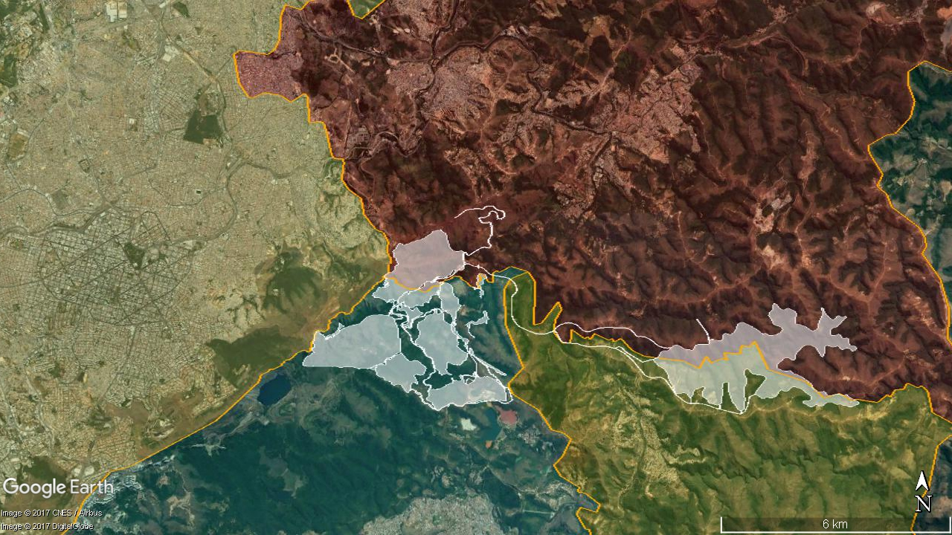
Localização (concepção original)
18.12.2014
Sabará
Belo Horizonte
Raposos
Nova Lima
Notes:
Page 5
As we’ve mentioned we have a unique location, being one of the last sizeable mining project in the heart of the Iron Ore Quadrangle not owned by a major mining or steel company.
Our project has inferred resources of 4.3 billion tonnes and potential reserves of 1.4 billion tonne with an average iron grade near 40%.
As you are probably familiar with, the Iron Ore Quadrangle is worldwide known for the high quality iron ore content of its deposits and for the existing and extremely efficient logistic solutions. Based on a drilling campaign and chemical tests conducted on the samples, we have been able to estimate the production cost and verify the low contaminant level of the deposit.
The major mining players have long standing operations in the iron ore quadrangle and have developed several logistic solutions for the iron ore transportation. Due to the government-owned and privately-operated nature of Brazil’s railway and port concessions, independent miners are able to take advantage of these first-in-class rail and port assets. On the top of that new, more efficient solutions based on slurry pipelines are under way and those are the reasons why we believe that logistics won’t be an issue for the Taquaril project.
In addition the State Government has already shown its support to our project, through the signature of the memorandum of understanding for the development of this project in the State of Minas Gerais.
Lastly, as mentioned there are several drivers of additional value creation, creating a significant upside potential to the Taquaril project. Moving to page 6

Slide 9
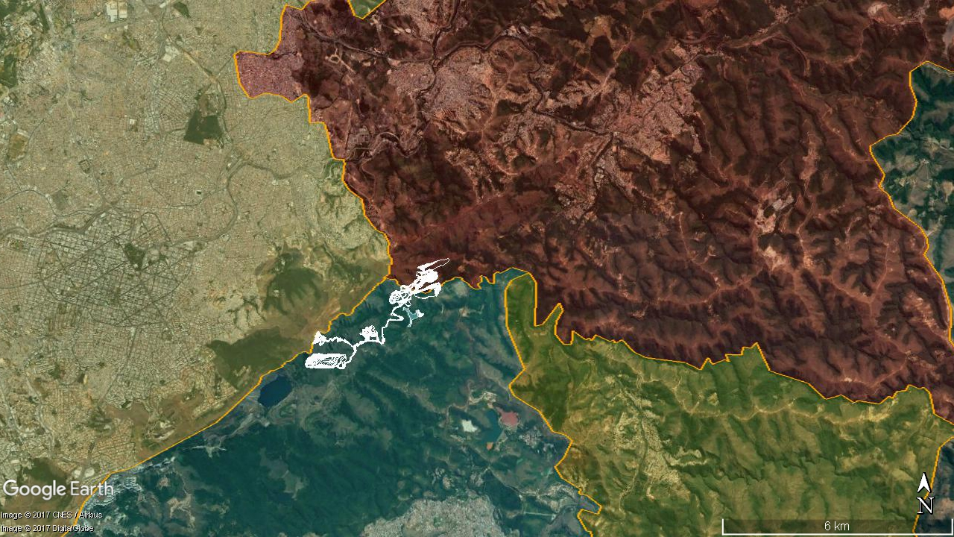
Localização (concepção atual)
07.11.2016
Sabará
Belo Horizonte
Raposos
Nova Lima
Notes:
Page 5
As we’ve mentioned we have a unique location, being one of the last sizeable mining project in the heart of the Iron Ore Quadrangle not owned by a major mining or steel company.
Our project has inferred resources of 4.3 billion tonnes and potential reserves of 1.4 billion tonne with an average iron grade near 40%.
As you are probably familiar with, the Iron Ore Quadrangle is worldwide known for the high quality iron ore content of its deposits and for the existing and extremely efficient logistic solutions. Based on a drilling campaign and chemical tests conducted on the samples, we have been able to estimate the production cost and verify the low contaminant level of the deposit.
The major mining players have long standing operations in the iron ore quadrangle and have developed several logistic solutions for the iron ore transportation. Due to the government-owned and privately-operated nature of Brazil’s railway and port concessions, independent miners are able to take advantage of these first-in-class rail and port assets. On the top of that new, more efficient solutions based on slurry pipelines are under way and those are the reasons why we believe that logistics won’t be an issue for the Taquaril project.
In addition the State Government has already shown its support to our project, through the signature of the memorandum of understanding for the development of this project in the State of Minas Gerais.
Lastly, as mentioned there are several drivers of additional value creation, creating a significant upside potential to the Taquaril project. Moving to page 6

Slide 10
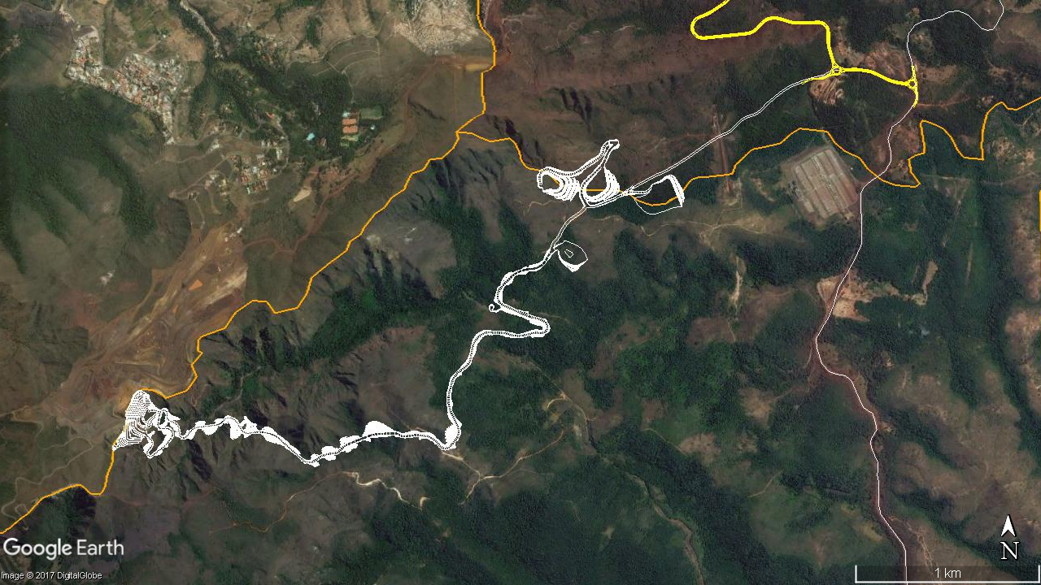
Arranjo Geral Fase 1
Belo Horizonte
Sabará
Pilhas
Planta
Estrada
Cava
Nova Lima
Notes:
Page 5
As we’ve mentioned we have a unique location, being one of the last sizeable mining project in the heart of the Iron Ore Quadrangle not owned by a major mining or steel company.
Our project has inferred resources of 4.3 billion tonnes and potential reserves of 1.4 billion tonne with an average iron grade near 40%.
As you are probably familiar with, the Iron Ore Quadrangle is worldwide known for the high quality iron ore content of its deposits and for the existing and extremely efficient logistic solutions. Based on a drilling campaign and chemical tests conducted on the samples, we have been able to estimate the production cost and verify the low contaminant level of the deposit.
The major mining players have long standing operations in the iron ore quadrangle and have developed several logistic solutions for the iron ore transportation. Due to the government-owned and privately-operated nature of Brazil’s railway and port concessions, independent miners are able to take advantage of these first-in-class rail and port assets. On the top of that new, more efficient solutions based on slurry pipelines are under way and those are the reasons why we believe that logistics won’t be an issue for the Taquaril project.
In addition the State Government has already shown its support to our project, through the signature of the memorandum of understanding for the development of this project in the State of Minas Gerais.
Lastly, as mentioned there are several drivers of additional value creation, creating a significant upside potential to the Taquaril project. Moving to page 6

Slide 11
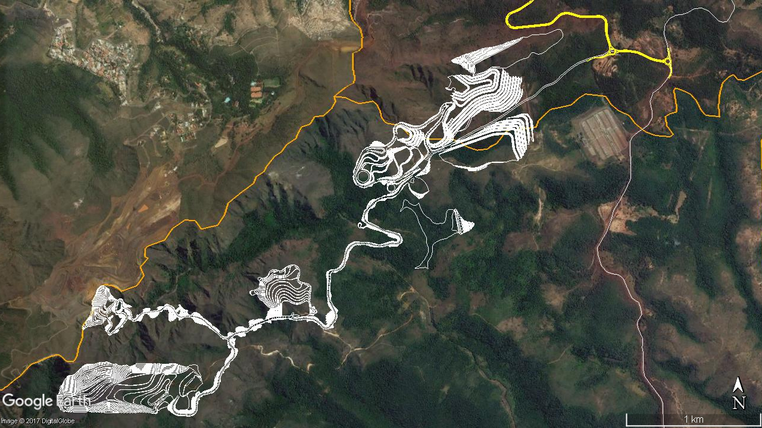
Arranjo Geral Fase 2
Belo Horizonte
Sabará
Cava
Planta
Pilhas
Estrada
Cava
Cava
Cava
Nova Lima
Notes:
Page 5
As we’ve mentioned we have a unique location, being one of the last sizeable mining project in the heart of the Iron Ore Quadrangle not owned by a major mining or steel company.
Our project has inferred resources of 4.3 billion tonnes and potential reserves of 1.4 billion tonne with an average iron grade near 40%.
As you are probably familiar with, the Iron Ore Quadrangle is worldwide known for the high quality iron ore content of its deposits and for the existing and extremely efficient logistic solutions. Based on a drilling campaign and chemical tests conducted on the samples, we have been able to estimate the production cost and verify the low contaminant level of the deposit.
The major mining players have long standing operations in the iron ore quadrangle and have developed several logistic solutions for the iron ore transportation. Due to the government-owned and privately-operated nature of Brazil’s railway and port concessions, independent miners are able to take advantage of these first-in-class rail and port assets. On the top of that new, more efficient solutions based on slurry pipelines are under way and those are the reasons why we believe that logistics won’t be an issue for the Taquaril project.
In addition the State Government has already shown its support to our project, through the signature of the memorandum of understanding for the development of this project in the State of Minas Gerais.
Lastly, as mentioned there are several drivers of additional value creation, creating a significant upside potential to the Taquaril project. Moving to page 6

Slide 12
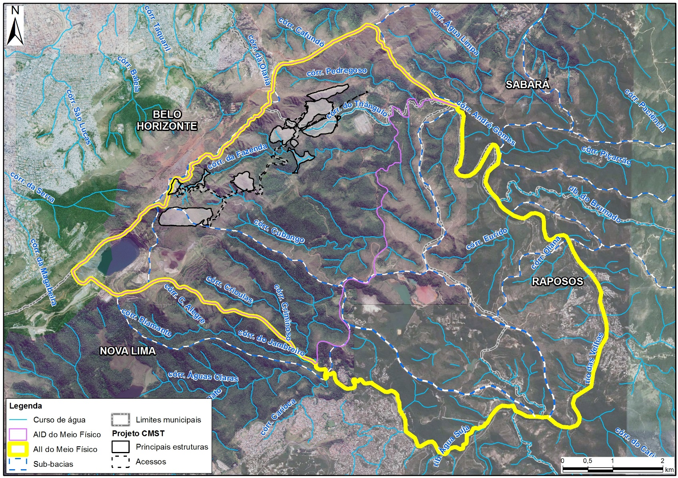

ÁREAS DE INFLUÊNCIA – MEIO FÍSICO
PROJETO CMST

Slide 13
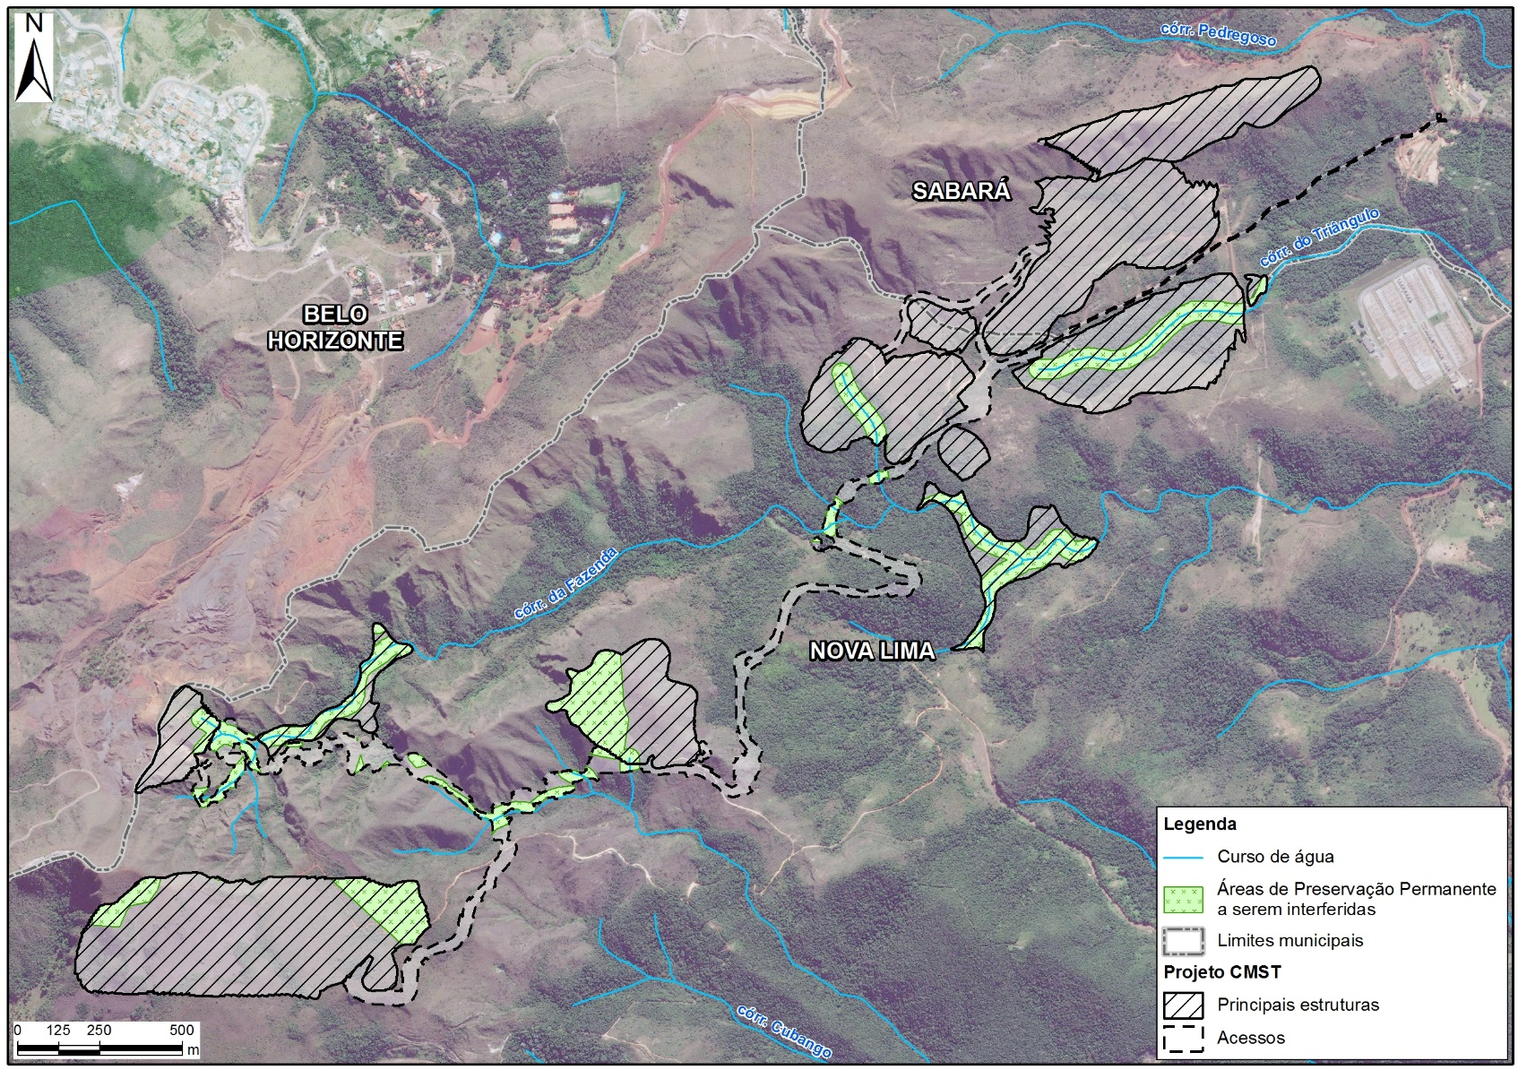
INTERFERÊNCIA EM ÁREAS DE PRESERVAÇÃO PERMANENTE (APPS) – PROJETO CMST

Slide 14
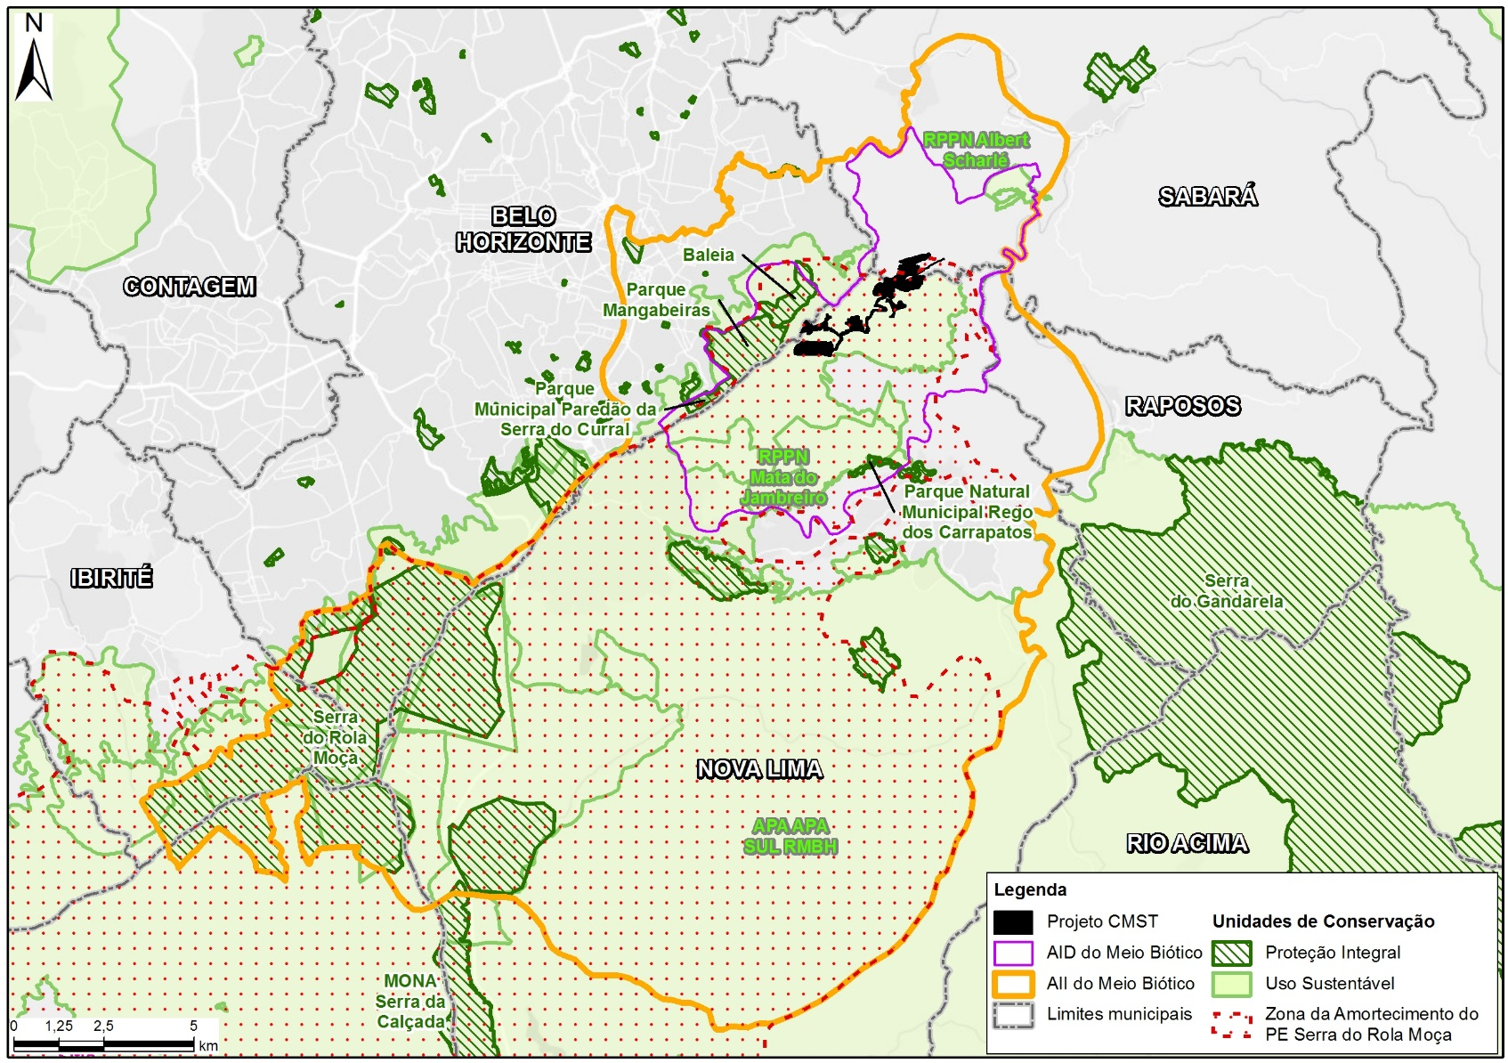
ÁREAS DE INFLUÊNCIA – MEIO BIÓTICO
– PROJETO CMST

Slide 15
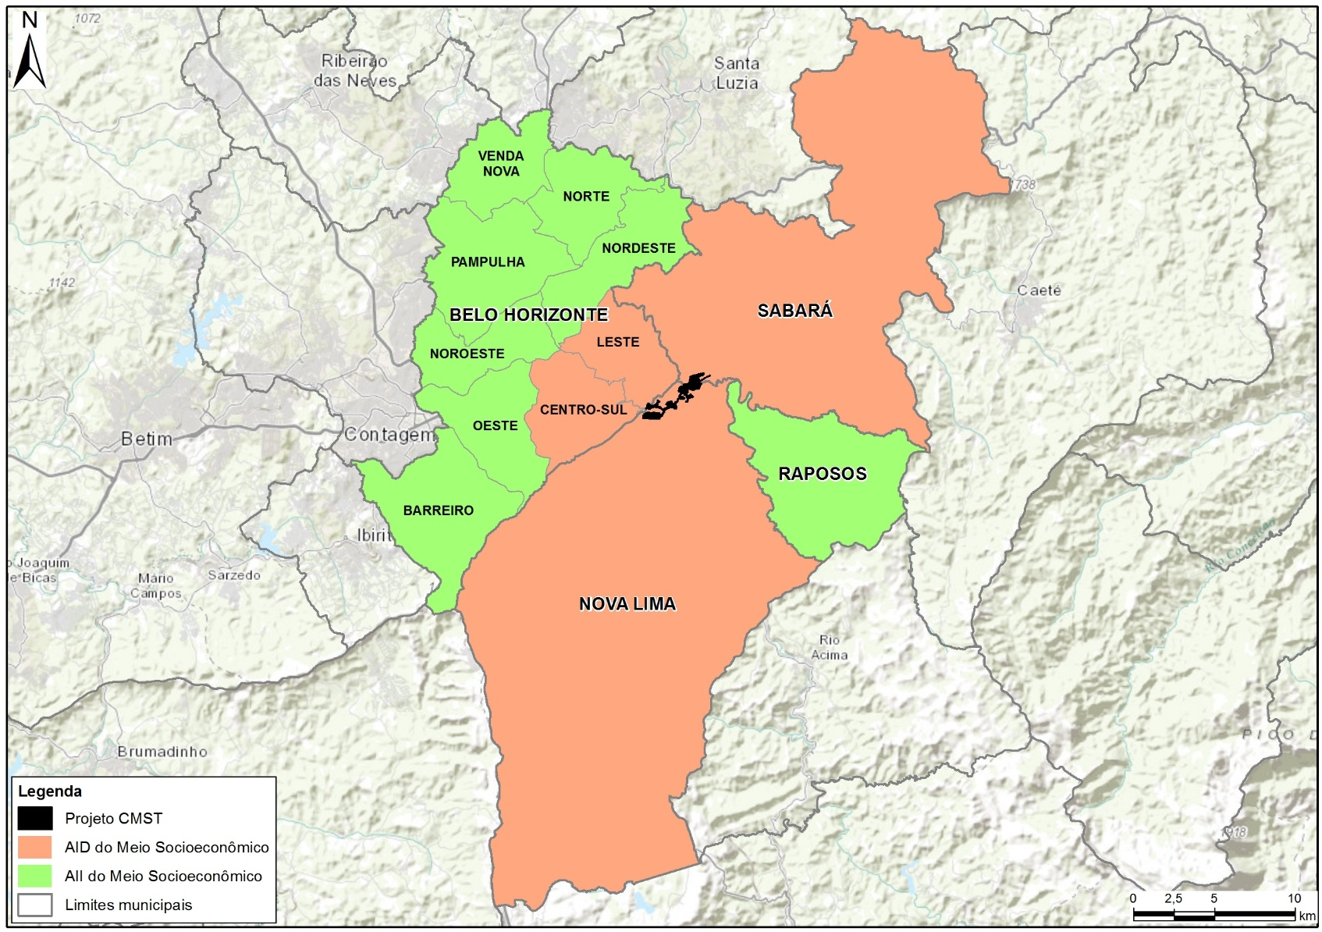
ÁREAS DE INFLUÊNCIA – MEIO SOCIOECONÔMICO
– PROJETO CMST

Slide 16
IMPACTOS NA SERRA DO CURRAL
A operação das Cava 1, não obstante, provocará uma descaracterização do entorno da área tombada do Pico Belo Horizonte e da Serra do Curral, em sua vertente sul, voltada para a cidade de Nova Lima.
Em relação à vertente norte, voltada para Belo Horizonte, a operação de lavra, notadamente no seu início, será visível de alguns pontos de Belo Horizonte, havendo assim um impacto visual, embora a linha de cumeada da Serra do Curral não virá a ser alterada pelo projeto como explicado anteriormente.
Diversus, p.25

Slide 17
Não obstante, é importante considerar a proximidade do projeto CMST a trechos da Serra do Curral tombados em nível tanto Federal quanto Municipal, pelo município de Belo Horizonte, e um efeito diretamente decorrente deste fato, que se trata da potencial percepção da sociedade de que o bem tombado estará sendo alterado em decorrência da operação do empreendimento. Neste contexto, sobretudo a população de Belo Horizonte estará sujeita a vivenciar este fenômeno ótico de caráter difuso pelo território do município, sendo fundamental a adoção de medidas igualmente difusas que contribuam para minimizar este inconveniente.
Dirversus, p.34

Slide 18
8.5.3 - Mobilização nas escolas
A equipe executora deste Programa selecionará até cinco escolas públicas, sobretudo aquelas localizadas nas Regionais Leste e Centro-Sul de Belo Horizonte (parte da AID no município) para a realização de um trabalho de estímulo à utilização dos materiais didáticos a respeito dos Tombamentos da Serra do Curral, que serão elaborados através deste projeto, através da adoção de atividades temáticas sobre o assunto, o que também será apoiado tanto pela página na internet quanto pelo livro.
Diversus, 36

Slide 19
Impactos
Impactos aproximado de 20 campos de futebol
Irá haverá supressão de matas nativas incluindo áreas de mata atlântica
Impactar e destruir cerca de 210 nascentes
Afetar cursos d’água de água classe especial e classe 1

Slide 20
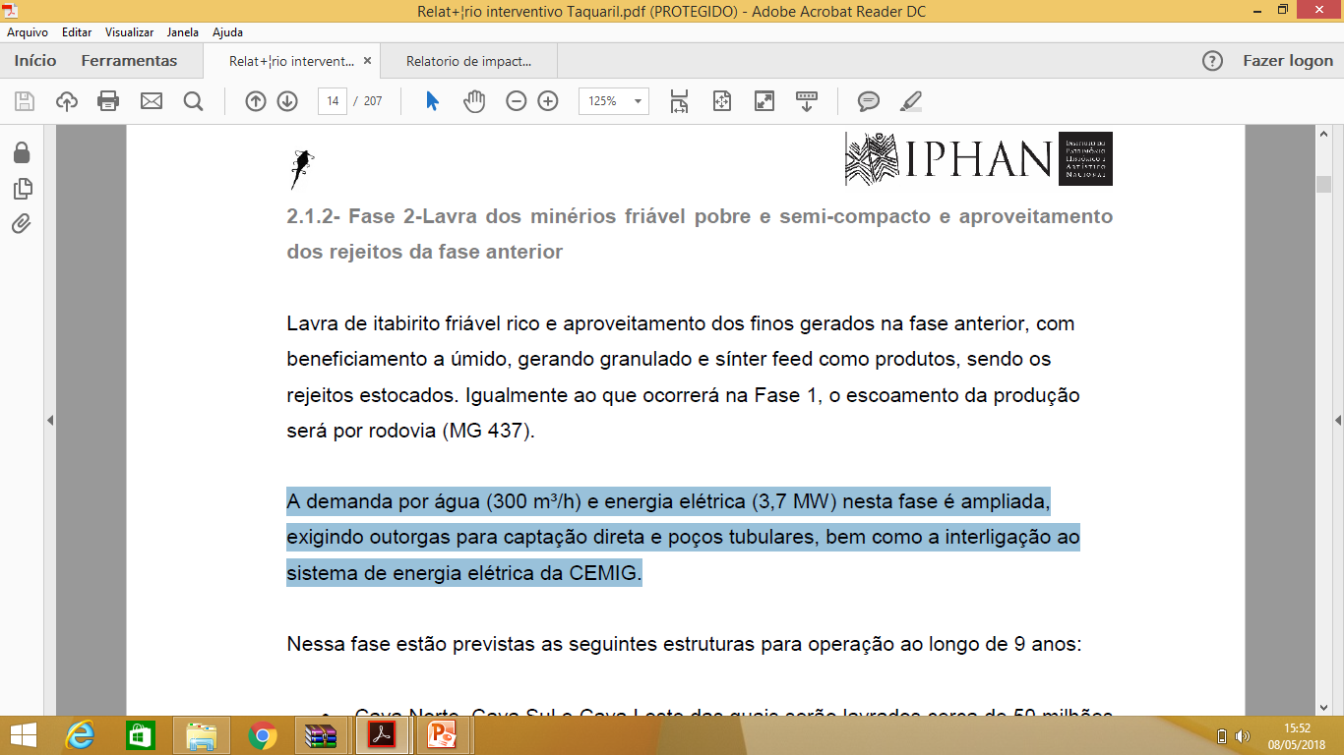

Slide 21
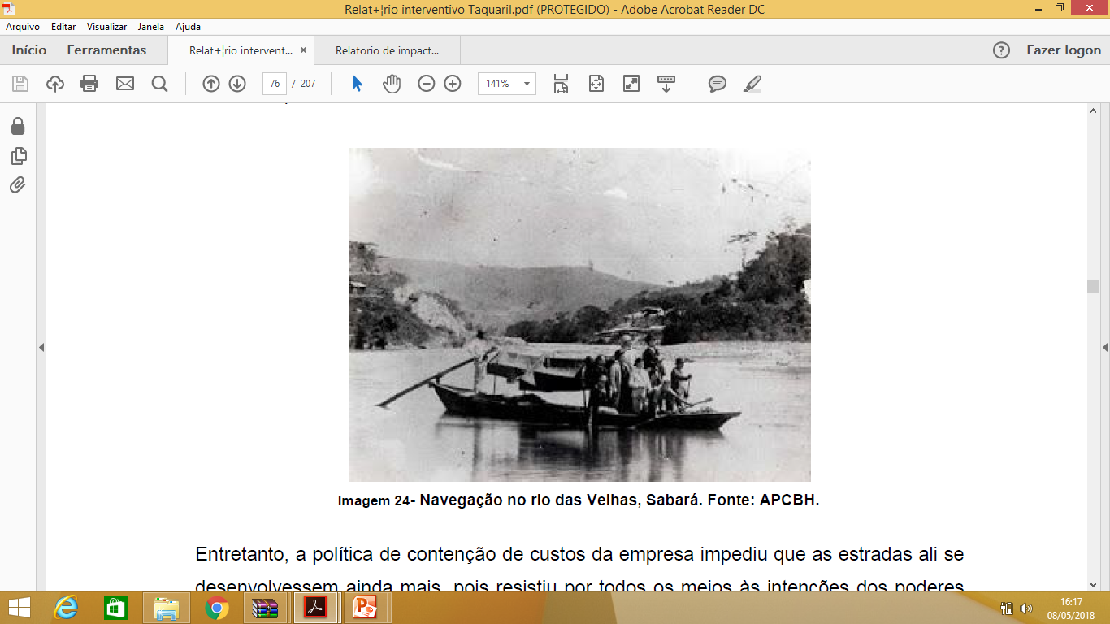

Slide 22
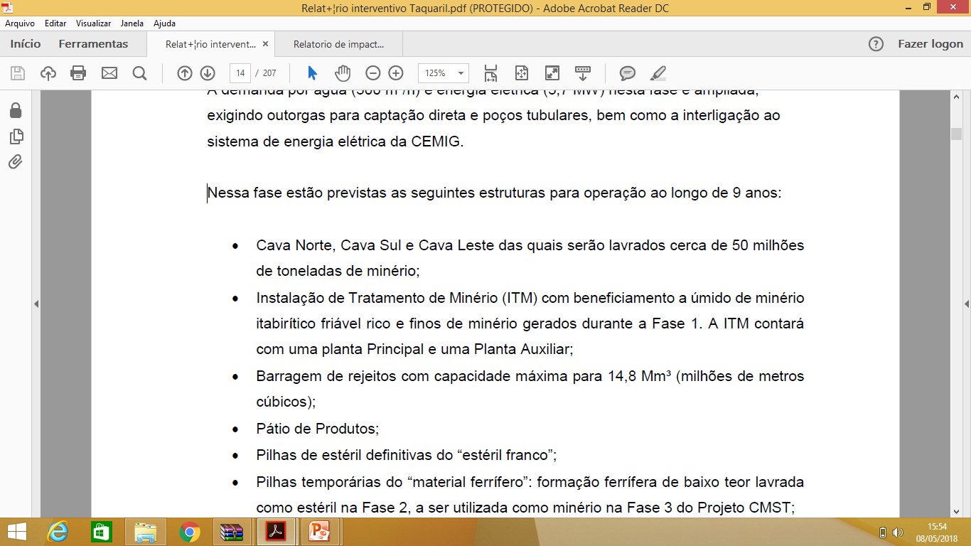

Slide 23
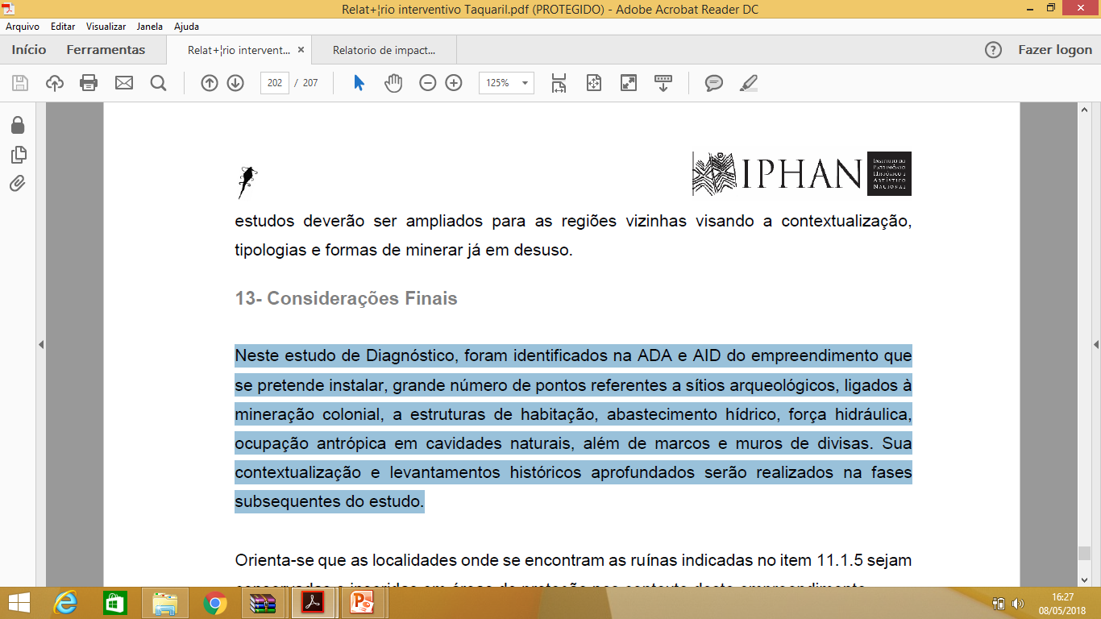

Slide 24
conclusões
Os valores ecossistêmicos (nascentes, riachos, córregos, fauna e flora, qualidade do ar, efeitos climáticos) são muito maiores, duradouros e permanentes do que a exploração econômica e danosa da região;
Belo Horizonte tem que ser colocada com AID
Necessariamente Belo Horizonte terá que fazer parte deste processo
Nada poderá substituir a história e a importância da Serra do Curral para Belo Horizonte e para Minas Gerais.
Acima de tudo somos Mineiros e não minérios
Queremos audiências públicas em Nova Lima, Rio Acima e Belo Horizonte

